Slide 1

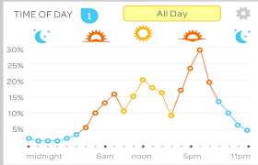
Start Page
Forecast Dropdown:
3 day forecast
Weekly Forecast
Accuracy Dropdown: Box & Whiskers Plot
Or
Multi-line graph
Yearly Weather
Raw data
42 degrees
42 degrees
Github page

Slide 2
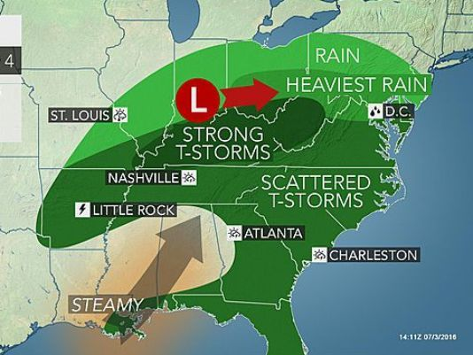

3 day and 7 day forecast map
Forecast Dropdown:
3 day forecast
Weekly Forecast
Accuracy Dropdown: Box & Whiskers Plot
Or
Multi-line graph
Yearly Weather
Raw data
3 day weekly
Github page

Slide 3
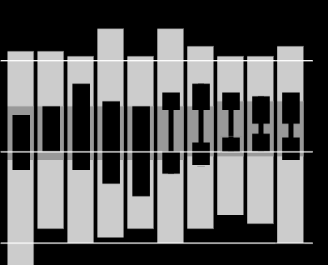
Box and Whiskers Plot
Forecast Dropdown:
3 day forecast
Weekly Forecast
Accuracy Dropdown: Box & Whiskers Plot
Or
Multi-line graph
Yearly Weather
Raw data
Github page

Slide 4
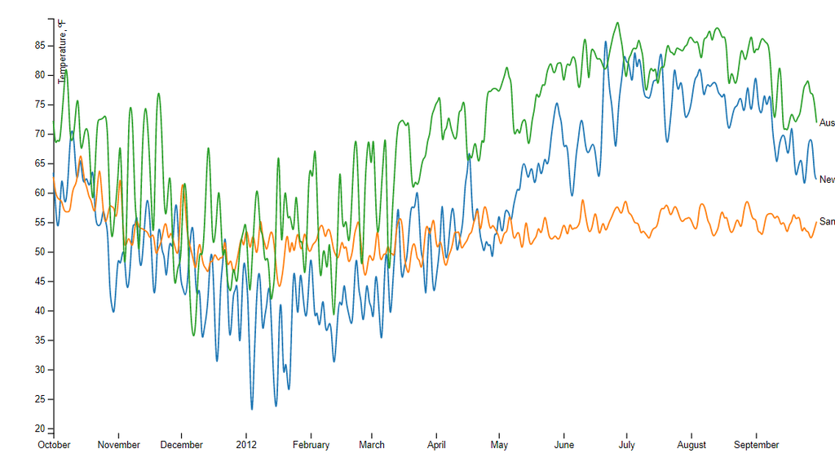
Prediction Line Graph
Forecast Dropdown:
3 day forecast
Weekly Forecast
Accuracy Dropdown: Box & Whiskers Plot
Or
Multi-line graph
Yearly Weather
Raw data
Github page

Slide 5
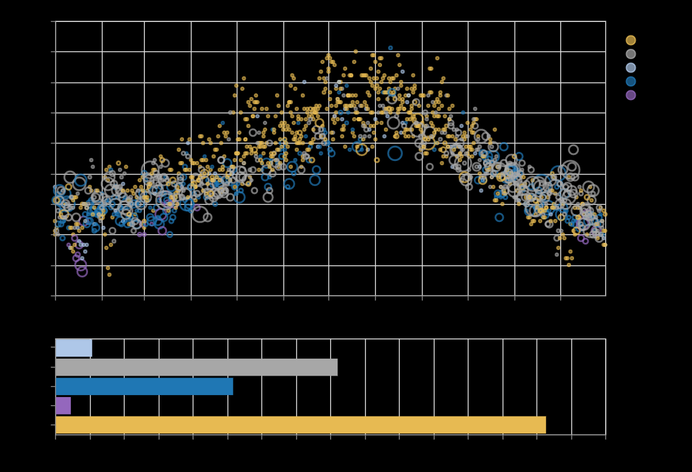
Yearly Weather
Forecast Dropdown:
3 day forecast
Weekly Forecast
Accuracy Dropdown: Box & Whiskers Plot
Or
Multi-line graph
Yearly Weather
Raw data
Github page

Slide 6
Raw Data
Forecast Dropdown:
3 day forecast
Weekly Forecast
Accuracy Dropdown: Box & Whiskers Plot
Or
Multi-line graph
Yearly Weather
Raw data
Github page

